Slide 1
PUBLIC PROCUREMENTS IN THE REPUBLIC OF SERBIA
Ms. Radulka Urosevic
Supreme State Auditor
Lisboa, 2017

Slide 2
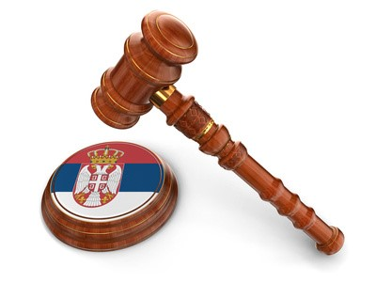
Legislative framework
Institutional framework
Public procurement audit

Slide 3
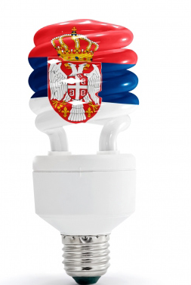
Legislative Framework of Public Procurements
Public Procurement Law (PPL)
First PPL - 2002;
Second PPL - 2008;
Third PPL - 2012.
Two changes and amendment to the third PPL:
1) 12th February 2015
2) 12th August 2015

Slide 4
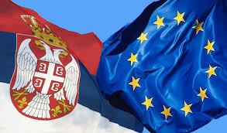
International Sources
Stabilization and Association Aggreement (2008)
New EU Directives:
2014/24/EU (classical sector – public sector),
2014/25/EU (special sector – communal services)
2014/23/ EU (concessions)
* Came into effect on 17th April 2014. Deadline for harmonization of EU Member States was 17th April 2016, except for e-procurements (17th Oct. 2018)
EU Directives:
2009/81/EZ (defense and security)
2007/66/EZ (protection of rights)
4

Slide 5
Regulations Significant for Public Procurements
Budget System Law – contracts on procurement of goods, provision of services or execution of works must be concluded in compliance with the legislation regulating public procurements.
Law on General Administrative Procedure – applied in protection of rights regarding issues not regulated via special regulations.
Law on Obligatory Relations – public procurement contract is one of the contracts used in the economy.
Law on Misdemeanors – defines misdemeanor procedure.

Slide 6
Regulations Referring to PPL
Law on Public-Private Partnership and Concessions – selection of private partner, and/or conclusion of contract on concession of public works and services and hiring a counsellor for realization of public-private partnerships.
Law on Communal Activities – Delegating performing of communal activities, financing of which is done from the budget of local self-government.
Criminal Code – Prescribes criminal act - Abuses regarding public procurements.

Slide 7
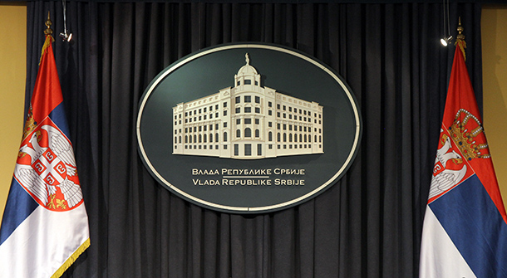
Who Adopted Bylaws
Government of the Republic of Serbia
5
REPUBLIC OF SERBIA
PUBLIC PROCUREMENT OFFICE
Public Procurement Office
7
Ministry of Economy
2

Slide 8
Bylaws - the Government of the Republic of Serbia
Decree on subject matter,manner of planning centralized public procurements and implementation of public procurement procedure by the Administration for Joint Services of the Republic Bodies, as a body in charge of centralized public procurements
Decree on determining general procurement dictionary
Decree on public procurement procedure in the field of defense and security
Decree on determining the List of Procuring Entities, for which the Administration for Joint Services of the Republic Bodies implements centralized public procurements
Decree on determining the List of Procuring Entities (referred to in Article 2, paragraph 1, Item 1 of the Public Procurement Law)

Slide 9
Bylaws - Public Procurement Office
Rulebook on Form of Public Procurement Plan and manner of publishing public procurement plan on the Public Procurement Portal
Rulebook on mandatory elements of tender documentation in the public procurement procedures and manner of proving fulfillment of conditions
Rulebook on form and content of the request for opinion regarding justification of application of negotiated procedure

Slide 10
Bylaws - Public Procurement Office
Rulebook on Civil Supervisor
Rulebook on content of enactment defining in more detail public procurement procedure within the procuring entity
Rulebook on manner and program of professional development and manner of taking professional exam for public procurement officer
Rulebook on content of the decision on implementation of public procurement procedure by multiple procuring entities

Slide 11
Bylaws - Ministry of Economy
Rulebook on manner of proving fulfillment of conditions that offered goods are domestic in origin
Rulebook on content of the Register of Bidders and documentation submitted along with application of bidder registration

Slide 12
Institutional Framework for Public Procurements
Public Procurement Office
Republic Commission for Protection of Rights in Public Procurement Procedures
State Audit Institution
Ministry of Finance
Commission for Competition Protection
Anti-Corruption Agency
Public-Private Partnership Commission

Slide 13
Public Procurement Office - Separate organization that supervises application of the Public Procurement Law.
Republic Commission for Protection of Rights in Public Procurement Procedures – Independent and autonomous body of the Republic of Serbia, which ensures protection of rights in public procurement procedures and manages misdemeanor procedure in the first instance.
State Audit Institution – The highest state authority for audit of public funds accountable to the National Assembly.

Slide 14
Ministry of Finance - Performs activities of state administration regarding the Republic Budget, system and tax policy, public expenditure policy as well as public procurements.
Commission for Competition Protection – Independent and autonomous organization that has public authorization in the area of competition protection.
Anti-Corruption Agency - independent and autonomous organization that exercises delegated authorization in the area of fight against corruption.
Public-Private Partnership Commission - provides professional assistance in realization of public-private partnerships and concessions - inter-sectoral public body operationally independent in its work. Founded by the Decision of the Government of the Republic of Serbia.

Slide 15
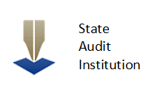
State Audit Institution (SAI)
Plans and conducts:
Financial statements audit,
Compliance audit,
Performance audit.

Slide 16
Within compliance audit:
it reviews whether financial transactions and decisions have been executed in compliance with the regulations defining public procurements.
Within performance audit:
it reviews whether funds, spent for public procurements, are in compliance with the principles of economy, efficiency and effectiveness.

Slide 17
Audit reports, as well as SAI Annual Activity Report submitted to the National Assembly, contain a separate chapter on detected irregularities in public procurement procedures, and are publicly available.

Slide 18
In 2016, within the Second Parallel Performance Audit Project, and within the Network of the SAIs of candidate and potential candidate countries and the European Court of Auditors, SAI commenced audit titled "Efficiency and economy of application of negotiated procedure without public invitation".
SAI will report on results of the audit in the end of 2017, when the audit is planned to be completed.

Slide 19
SAI contribution to fight against corruption
Corruption perception is present in all fields of public sector, and is often connected to public procurement procedures.

Slide 20
SAI:
Audits all three phases of public procurements (planning, implementation and reporting);
Audits confidential procurements as well;
Files misdemeanor and criminal charges for the detected irregularities;
Increases level of transparency and reliability of reporting in public procurements;
Issues recommendations and improves operations of public funds beneficiaries in the area of public procurements.

Slide 21
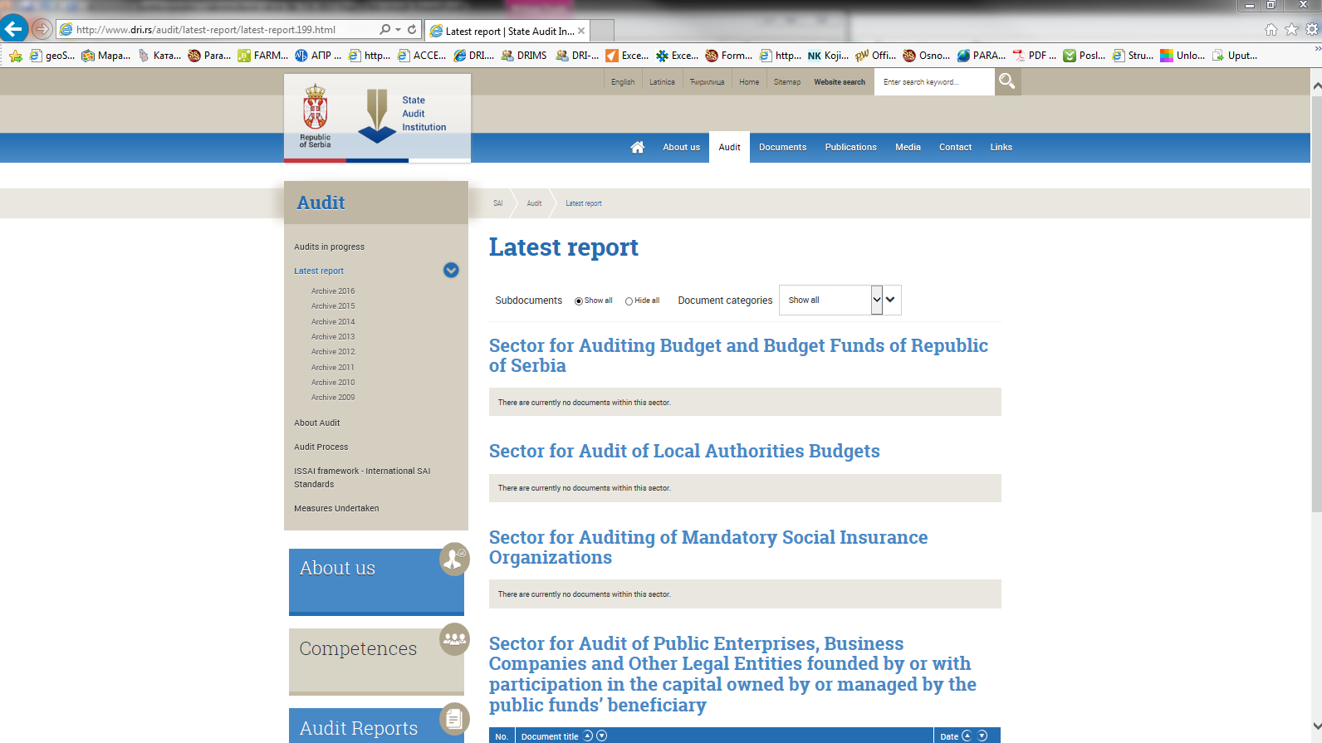
SAI publishes audit reports on the website – www.dri.rs
So far, SAI has published over 750 audit reports, in which more than 7.500 recommendations were issued, out of which large number pertains to public procurements.

Slide 22
Reports on:
number of recommendations,
number of filed:
- requests for initiating misdemeanor procedures,
- economic offense charges,
- criminal charges.
So far, close to 400 requests for initiating misdemeanor procedures were filed, in the field of public procurements, and 22 information to prosecutor's offices regarding irregularities that may have characteristics of criminal offense.

Slide 23
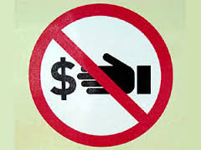
SAI issues recommendations for changes of laws based on information it collected during the public procurement audit process, which produce or may produce negative consequences:
Centralized public procurements have been introduced;
Public Procurement Law was amended, in part of prescribing misdemeanor offenses and statute of limitations period was prolonged, which reduces the risk of statute of limitations of filed requests;
Criminal Code introduced criminal offense - Abuses regarding public procurements.

Slide 24
According to the data for the period 2011-2015, there is a tendency of reducing both absolute amount and % of participation of the irregularities in public procurement procedures.
It was particularly reduced in the area of concluding contracts without implementation of public procurement procedure .
Reduction of the amount of irregularities is noticed particularly in the area of planning, application of appropriate procedures and implementation of negotiated procedure with/without public invitation.

Slide 25
Observed per auditees, significant participation of irregularities in overall audited amount of public procurements is detected with local authorities' budgets (32%) and public enterprises (23%).

Slide 26
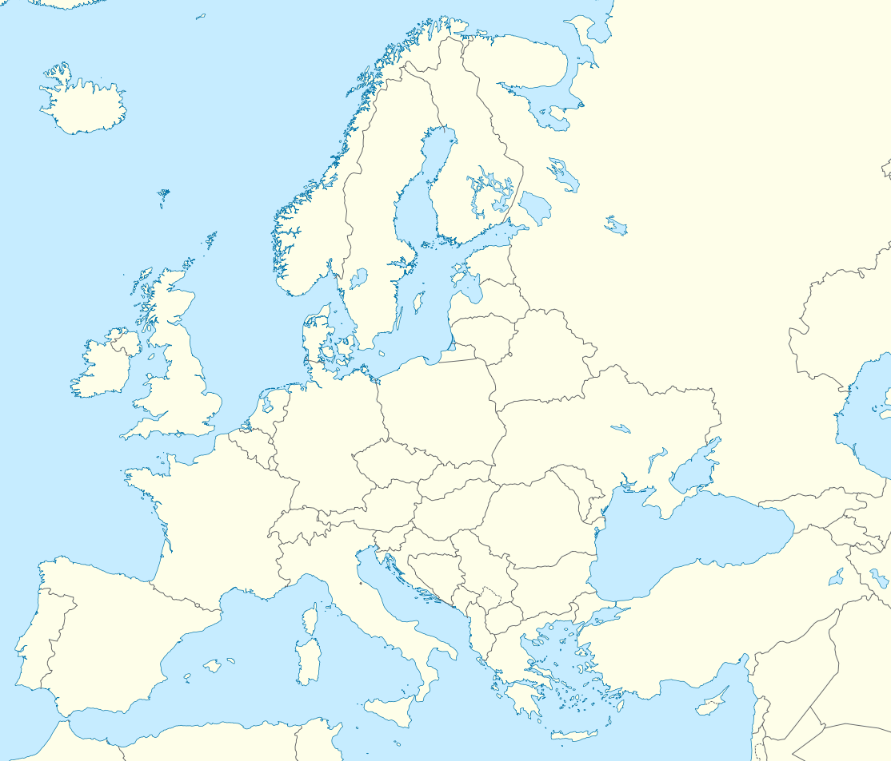
Thank you for you attention! Visit us at www.dri.rs

